Slide 1
COMP3074 Mobile App Development I
Week 7

Slide 2
Topics for today
Content providers
Publishing and signing the app

Slide 3
Content Provider Objective
An Android app by default cannot access another app’s data. This is the cornerstone of Android security, the principle of sandboxing. But often, you do want an app to share some data with others. Content providers are such an interface to data so that the data cab be mashed together across apps.
Example of Content Provider
Content Providers share content with applications across application boundaries.
Examples of built-in Content Providers in Android OS are: Contacts, MediaStore, Bookmarks, Settings and more.

Slide 4
Content Providers
Content provider are used to share data across packages in Android apps
Think of a content provider as a data store.
A content provider behaves very much like a database — you can query it, edit its content, as well as add or delete content.
Unlike a database, a content provider can use different ways to store its data.
The data can be stored in a database, in files, or even over a network.

Slide 5
Built-in Content Providers
Browser — Stores data such as browser bookmarks, browser history, etc.
CallLog — Stores data such as missed calls, call details, etc.
Contacts — Stores contact details
MediaStore — Stores media files such as audio, video, and images
Settings — Stores the device’s settings and preferences

Slide 6
Built-in Content Providers
To query a content provider, you specify the query string in the form of a URI, with an optional specifier for a particular row.
The format of the query URI is as follows:
<standard_prefix>://<authority>/<data_path>/<id>
The various parts of the URI are as follows:
The standard prefix for content providers is always content://.
The authority specifies the name of the content provider.
An example would be contacts for the built-in Contacts content provider.

Slide 7
Built-in Content Providers
For third-party content providers, this could be the fully qualified name, such as com.wrox.provider or net.learn2develop.provider.
The data path specifies the kind of data requested.
For example, if you are getting all the contacts from the Contacts content provider, then the data path would be people, and the URI would look like this: content://contacts/people.
The id specifies the specific record requested.
For example, if you are looking for contact number 2 in the Contacts content provider, the URI would look like this:
content://contacts/people/2

Slide 8
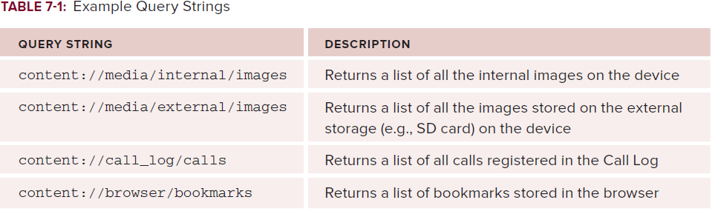
Built-in Content Providers

Slide 9
Accessing a Content Provider
A client application accesses the data from a content provider with a ContentResolver object.
The ContentResolver object provides query(), insert(), update(), and delete() methods for accessing data from a content provider.
The ContentResolver object invokes identically-named methods on an instance of a concrete subclass of ContentProvider, which typically resides in a separate application process.
The ContentProvider acts as an abstraction layer between its data store and the external presentation of data.
The ContentResolver object and the ContentProvider object automatically handle the details of inter-process communication.

Slide 10
CRUD
Content providers support the four basic operations, normally called CRUD-operations. CRUD is the acronym for create, read, update and delete. With content providers those objects simply represent data – most often a record (tuple) of a database – but they could also be a photo on your SD-card or a video on the web.
Content URIs
The most important concept to understand when dealing with content providers is the content URI. Whenever you want to access data from a content provider you have to specify a URI. URIs for content providers look like this:
content://authority/optionalPath/optionalId

Slide 11
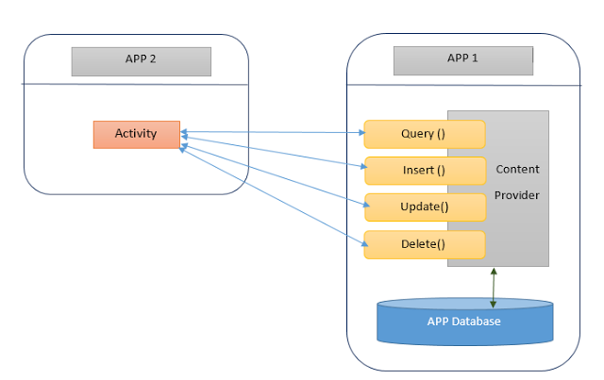
Below diagram shows how content provider works. App 1 stores its data in its own database and provides a provider. App 2 communicates with the provider to access App 1's data.

Slide 12
Using a Content Provider
Provider example
https://examples.javacodegeeks.com/android/core/provider/android-contacts-example/
In this example we are going to see how to get Contact Information on your own Android Application. This is an example that demonstrates the appropriate queries (basically there are translated to SQLite queries) you should use in order to get the information you want about Contacts. Of course you can customize the display of the Contact List (here we use just a simple TextView).
Notes:
https://developer.xamarin.com/guides/android/platform_features/intro_to_content_providers/part_1_-_how_it_works/
http://developer.android.com/training/contacts-provider/index.html

Slide 13
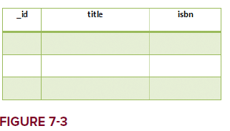
Create custom Content Providers
Create your own content provider in Android by extending the abstract ContentProvider class and override the various methods defined within it.
Example: learn how to create a simple content provider that stores a list of books.
The content provider stores the books in a database table containing three fields, as shown in Figure 7-3.

Slide 14
Create custom Content Providers
First, create a class named BooksProvider that extends the ContentProvider
Override the following methods:
getType() — Returns the MIME type of the data at the given URI
onCreate() — Called when the provider is started
query() — Receives a request from a client. The result is returned as a Cursor object.
insert() — Inserts a new record into the content provider
delete() — Deletes an existing record from the content provider
update() — Updates an existing record from the content provider

Slide 15
ContentProviders example
Within your content provider, you are free to choose how you want to store your data — a traditional file system, XML, a database, or even through web services.
For this example, you can use an SQLite database
Use an UriMatcher object to parse the content URI that is passed to the content provider through a ContentResolver.
For example, the following content URI represents a request for all books in the content provider:
content://net.learn2develop.provider.Books/books
The following represents a request for a particular book with _id 5:
content://net.learn2develop.provider.Books/books/5

Slide 16
ContentProviders example
Use the SQLiteOpenHelper helper class to help manage your database:
private static class DatabaseHelper extends SQLiteOpenHelper
{
DatabaseHelper(Context context) {
super(context, DATABASE_NAME, null, DATABASE_VERSION);
}
@Override
public void onCreate(SQLiteDatabase db)
{
db.execSQL(DATABASE_CREATE);
}
@Override
public void onUpgrade(SQLiteDatabase db, int oldVersion, int newVersion)
{
Log.w(“Content provider database”,
“Upgrading database from version “ +
oldVersion + “ to “ + newVersion +
“, which will destroy all old data”);
db.execSQL(“DROP TABLE IF EXISTS titles”);
onCreate(db);
}
}

Slide 17
Overriding ContentProvider methods
@Override
public String getType(Uri uri)
{
switch (uriMatcher.match(uri))
{
//---get all books---
case BOOKS:
return “vnd.android.cursor.dir/vnd.learn2develop.books “;
//---get a particular book---
case BOOK_ID:
return “vnd.android.cursor.item/vnd.learn2develop.books “;
default:
throw new IllegalArgumentException(“Unsupported URI: “ + uri);
}
}

Slide 18
ContentProviders example
@Override
public Cursor query(Uri uri, String[] projection, String selection,
String[] selectionArgs, String sortOrder)
{
SQLiteQueryBuilder sqlBuilder = new SQLiteQueryBuilder();
sqlBuilder.setTables(DATABASE_TABLE);
if (uriMatcher.match(uri) == BOOK_ID)
//---if getting a particular book---
sqlBuilder.appendWhere(
_ID + “ = “ + uri.getPathSegments().get(1));
if (sortOrder==null || sortOrder==””)
sortOrder = TITLE;

Slide 19
ContentProviders example
Cursor c = sqlBuilder.query(
booksDB,
projection,
selection,
selectionArgs,
null,
null,
sortOrder);
//---register to watch a content URI for changes---
c.setNotificationUri(getContext().getContentResolver(), uri);
return c;
}

Slide 20
ContentProviders example
@Override
public Uri insert(Uri uri, ContentValues values)
{
//---add a new book---
long rowID = booksDB.insert( DATABASE_TABLE, “”, values);
//---if added successfully---
if (rowID>0)
{
Uri _uri = ContentUris.withAppendedId(CONTENT_URI, rowID);
getContext().getContentResolver().notifyChange(_uri, null);
return _uri;
}
throw new SQLException(“Failed to insert row into “ + uri);
}

Slide 21
ContentProviders example
@Override
public int delete(Uri arg0, String arg1, String[] arg2)
{
// arg0 = uri
// arg1 = selection
// arg2 = selectionArgs
int count=0;
switch (uriMatcher.match(arg0)){
case BOOKS:
count = booksDB.delete(
DATABASE_TABLE,
arg1,
arg2);
break;

Slide 22
ContentProviders example
case BOOK_ID:
String id = arg0.getPathSegments().get(1);
count = booksDB.delete(
DATABASE_TABLE,
_ID + “ = “ + id +
(!TextUtils.isEmpty(arg1) ? “ AND (“ +
arg1 + ‘)’ : “”),
arg2);
break;
default: throw new IllegalArgumentException(“Unknown URI “ + arg0);
}
getContext().getContentResolver().notifyChange(arg0, null);
return count;
}

Slide 23
ContentProviders example
@Override
public int update(Uri uri, ContentValues values, String selection,
String[] selectionArgs) {
int count = 0;
switch (uriMatcher.match(uri)){
case BOOKS:
count = booksDB.update(
DATABASE_TABLE,
values,
selection,
selectionArgs);
break;

Slide 24
ContentProviders example
case BOOK_ID:
count = booksDB.update(
DATABASE_TABLE,
values,
_ID + “ = “ + uri.getPathSegments().get(1) +
(!TextUtils.isEmpty(selection) ? “ AND (“ +
selection + ‘)’ : “”),
selectionArgs);
break;
default: throw new IllegalArgumentException(“Unknown URI “ + uri);
}
getContext().getContentResolver().notifyChange(uri, null);
return count;
}

Slide 25
ContentProviders example
Finally, to register your content provider with Android, modify the AndroidManifest.xml file by adding the <provider> element:
<provider android:name=”BooksProvider”
android:authorities=”net.learn2develop.provider.Books”>
</provider>

Slide 26
Using the Content Provider - insert
Test your new content provider from within your Android application:
To add a book to the content provider, you create a new ContentValues object and then populate it with the various information about a book:
//---add a book---
ContentValues values = new ContentValues();
values.put(BooksProvider.TITLE, ((EditText)
findViewById(R.id.txtTitle)).getText().toString());
values.put(BooksProvider.ISBN, ((EditText)
findViewById(R.id.txtISBN)).getText().toString());
Uri uri = getContentResolver().insert(
BooksProvider.CONTENT_URI, values);

Slide 27
Using the Content Provider - insert
To access this content provider from another package, you need to specify the field name directly, like this:
ContentValues values = new ContentValues();
values.put(“title”, ((EditText)
findViewById(R.id.txtTitle)).getText().toString());
values.put(“isbn”, ((EditText)
findViewById(R.id.txtISBN)).getText().toString());
Uri uri = getContentResolver().insert(
Uri.parse(
“content://net.learn2develop.provider.Books/books”),
values);

Slide 28
Using the Content Provider - insert
Note that for external packages, you need to refer to the content URI using the fully qualified content URI:
Uri uri = getContentResolver().insert(
Uri.parse(
“content://net.learn2develop.provider.Books/books”),
values);

Slide 29
Using the Content Provider - retrieve
//---retrieve the titles---
Uri allTitles = Uri.parse(“content://net.learn2develop.provider.Books/books”);
Cursor c;
if (android.os.Build.VERSION.SDK_INT <11) {
//---before Honeycomb---
c = managedQuery(allTitles, null, null, null,“title desc”);
}
else
{
//---Honeycomb and later---
CursorLoader cursorLoader = new CursorLoader(
this, allTitles, null, null, null,“title desc”);
c = cursorLoader.loadInBackground();
}

Slide 30
Using the Content Provider - retrieve
if (c.moveToFirst()) {
do
{
Toast.makeText(this,
c.getString(c.getColumnIndex(
BooksProvider._ID)) + “, “ +
c.getString(c.getColumnIndex(
BooksProvider.TITLE)) + “, “ +
c.getString(c.getColumnIndex(
BooksProvider.ISBN)),
Toast.LENGTH_SHORT).show();
} while (c.moveToNext());
}

Slide 31
Using the Content Provider - update
If you want to update a book’s detail, call the update() method with the content URI, indicating the book’s ID:
ContentValues editedValues = new ContentValues();
editedValues.put(BooksProvider.TITLE, “Android Tips and Tricks”);
getContentResolver().update(
Uri.parse(
“content://net.learn2develop.provider.Books/books/2”),
editedValues,
null,
null);

Slide 32
Using the Content Provider - delete
To delete a book, use the delete() method with the content URI, indicating the book’s ID:
//---delete a title---
getContentResolver().delete(
Uri.parse(“content://net.learn2develop.provider.Books/books/2”),
null, null);

Slide 33
References
Textbook
Android Documentation

Slide 34
Publishing Android Apps
Objectives:
Create a good understanding of Android deployment features.
Digitally sign and deploy APK files.
Create a good understanding of publishing process.

Slide 35
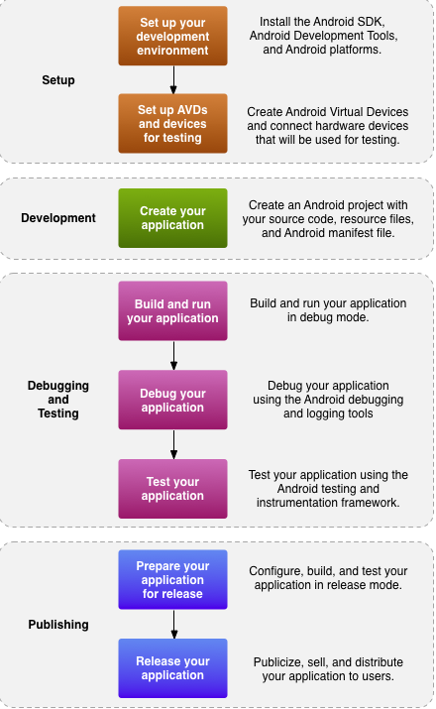
The development process for Android Apps

Slide 36
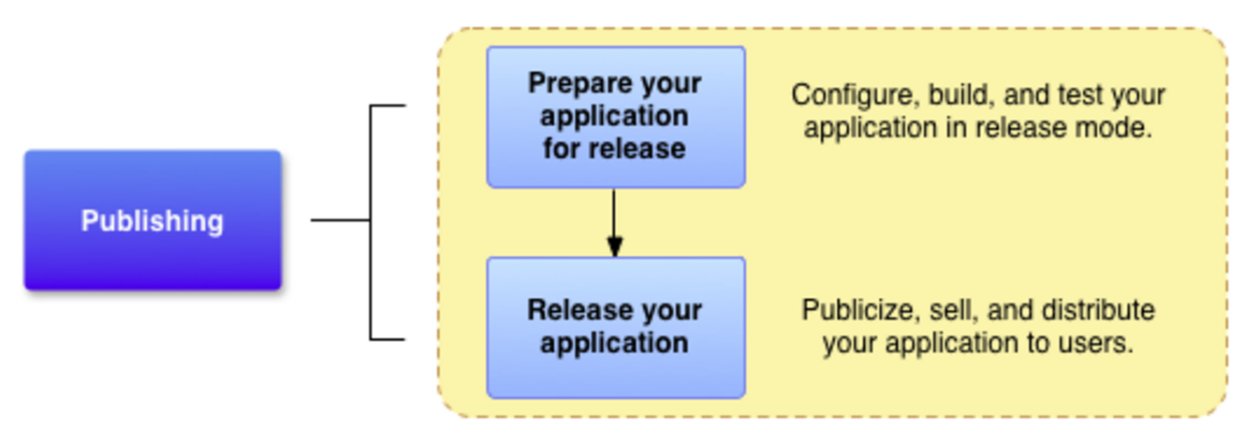
Publishing Android Apps
Publishing an Android application includes two main tasks:
Prepare the application for release
build a release version of your application, which users can download and install on their Android-powered devices.
Release the application to users
publicize, sell, and distribute the release version of your application to users.

Slide 37
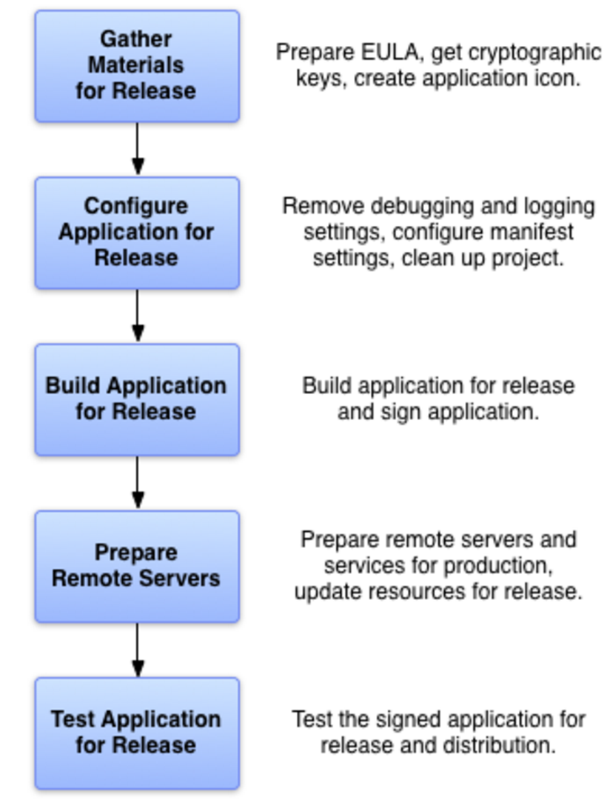
Preparing App for Release
Five main tasks:

Slide 38
Versioning Your Application
If you are planning to publish your application on the Android Market (www.android.com/market/), the AndroidManifest.xml file must have the following attributes:
android:versionCode (within the <manifest> element) - An integer value that represents the version of the application code, relative to other versions.
android:versionName (within the <manifest> element) - string value that represents the release version of the application code, as it should be shown to users.
android:icon (within the <application> element)
android:label (within the <application> element)

Slide 39
Versioning Your Application
<?xml version="1.0" encoding="utf-8"?>
<manifest xmlns:android="http://schemas.android.com/apk/res/android"
package="com.example.inika.transittest" >
android:versionCode=”1”
android:versionName=”1.0” >
<uses-sdk
android:minSdkVersion="12"
android:targetSdkVersion="15" />
<uses-permission android:name="android.permission.INTERNET"/>
<uses-permission android:name="android.permission.ACCESS_COARSE_LOCATION" />
<uses-permission android:name="android.permission.ACCESS_FINE_LOCATION" />
<application
android:allowBackup="true"
android:icon="@mipmap/ic_launcher"
android:label="@string/app_name"
android:theme="@style/AppTheme" >
<activity
android:name=".MainActivity"
android:label="@string/app_name" >
<intent-filter>
<action android:name="android.intent.action.MAIN" />
<category android:name="android.intent.category.LAUNCHER" />
</intent-filter>
</activity>
</application>
</manifest>

Slide 40
API Level requirements
Add a <uses-sdk> element in the application's manifest, with one or more of these attributes:
android:minSdkVersion - the minimum version of the Android platform on which the application will run, specified by the platform's API Level identifier.
android:targetSdkVersion - the API Level on which the application is designed to run.
android:maxSdkVersion - the maximum version of the Android platform on which the application is designed to run, specified by the platform's API Level identifier.

Slide 41
Signing Your Apps
You can sign an app in debug or release mode
You sign your app in debug mode during development and in release mode when you are ready to distribute your app.
The Android SDK generates a certificate to sign apps in debug mode.
To sign apps in release mode, you need to generate your own certificate.

Slide 42
Digitally Signing Your Android Applications
In release mode, you sign your app with your own certificate:
Create a keystore - a binary file that contains a set of private keys.
You must keep your keystore in a safe and secure place.
Create a private key - represents the entity to be identified with the app, such as a person or a company.
Add the signing configuration to the build file for the app module – Android Studio does that.

Slide 43
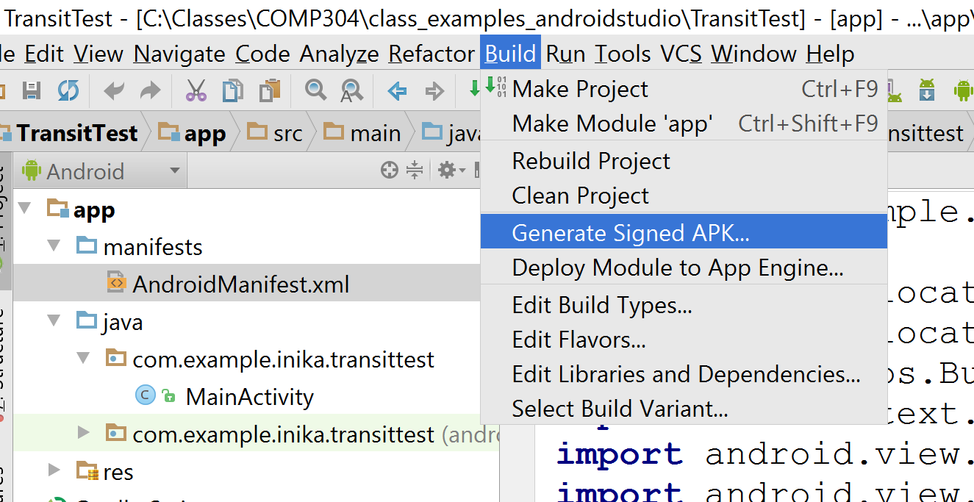
Digitally Signing Your Android Applications
In Android Studio, we can choose Generate Signed APK... option from Build menu

Slide 44
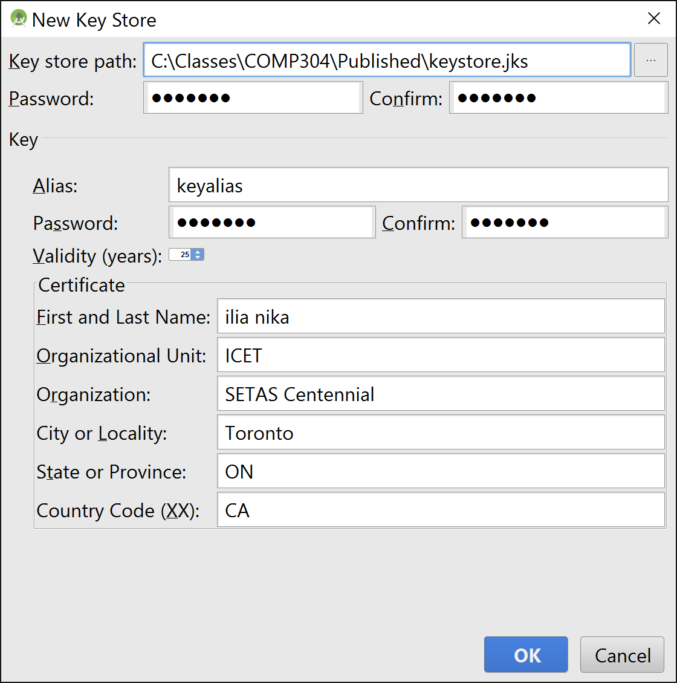
Creating a new Keystore
On the Generate Signed APK Wizard window, click Create new to create a new keystore - provide keystore path, password to protect the private key, a validity period for the key, minimum 25 years, key alias and other information:

Slide 45
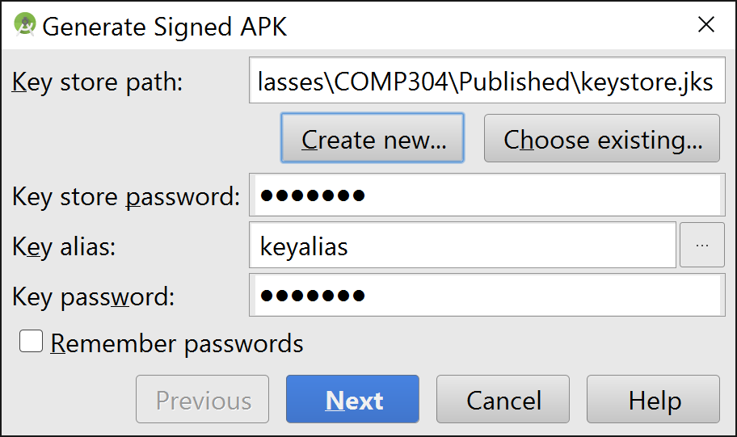
Creating a new Keystore
Enter a path to save your new keystore
Enter a password to protect the keystore

Slide 46
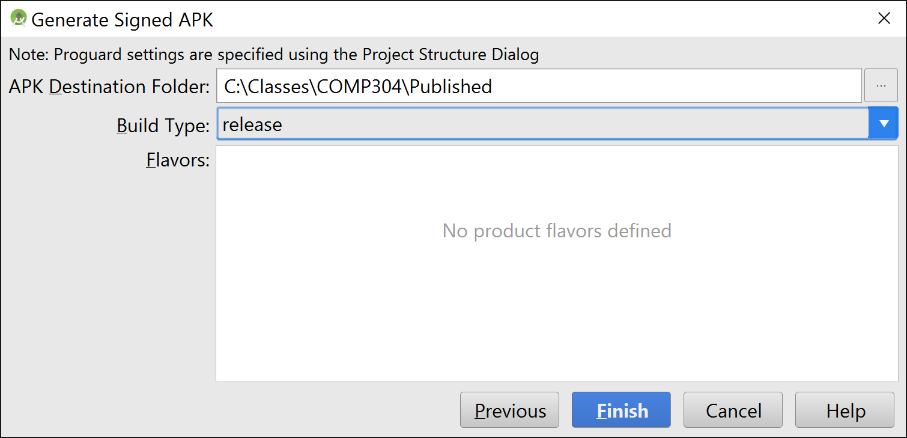
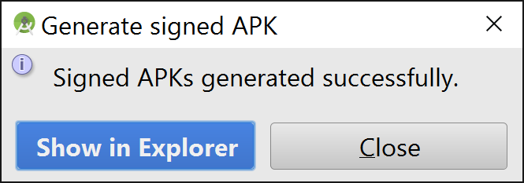
Creating APK file
Store the destination APK file

Slide 47
Automatically Signing Your App
In Android Studio, you can configure your project to sign your release APK automatically during the build process:
On the project browser, right click on your app and select Open Module Settings.
On the Project Structure window, select your app's module under Modules.
Click on the Signing tab.
Select your keystore file, enter a name for this signing configuration (as you may create more than one), and enter the required information.

Slide 48
DEPLOYING APK FILES
Use one of the following three methods to deploy an Android app to an Android device:
Deploying manually using the adb.exe tool
Hosting the application on a web server
Publishing through the Google Play

Slide 49
Using adb.exe
You can deploy an Android app to emulators and devices using the adb.exe (Android Debug Bridge) tool (located in the platform-tools folder of the Android SDK).
To install the application to an emulator/device (assuming the emulator is currently up and running or a device is currently connected), use the following command:
adb install “C:\Temp\app-release.apk”
You can view the devices currently connected to your computer by using the devices option with adb:
adb devices

Slide 50
Using a Web Server
Copy the signed UITest.apk file to your web app root directory
Create a new HTML file named index.html with the following content:
<html>
<title>UITest application</title>
<body>
Download the Where Am I application <a href=”UITest.apk”>here</a>
</body>
</html>
You may need to register a new MIME type for the APK file. The MIME type for the .apk extension is application/vnd.android.package-archive

Slide 51
Using a Web Server
For installation over a web server, you need to configure your Android emulator/device to accept applications from non-Market sources.
In the Settings application, click the Security item and scroll to the bottom of the screen.
Check the “Unknown sources” item.
You will be prompted with a warning message.
Click OK.
Checking this item will allow the emulator/device to install applications from other non-Market sources (such as from a web server).

Slide 52
Publishing on the Google Play
A better way is to host your application on the Google Play, a Google-hosted service that makes it very easy for users to discover and download (i.e., purchase) applications for their Android devices.
Users simply need to launch the Google Play application on their Android device in order to discover a wide range of applications that they can install on their devices.

Slide 53
Publishing Checklist
1. Understand the Publishing Process
2. Understand Google Play Policies
3. Test for Core App Quality
4. Determine Content Rating
5. Determine Country Distribution
6. Confirm Overall Size
7. Confirm Platform and Screen Ranges
8. Decide Free or Priced
9. Use In-app Billing
10. Set Prices for your Products
11. Start Localization
12. Prepare Promotional Graphics, Screenshots, and Videos
13. Build the Release-ready APK
14. Plan a Beta Release
15. Complete the Store Listing
16. Use Google Play Badges and Links
17. Final Checks and Publishing
18. Support Users after Launch

Slide 54
Creating a Developer Profile
The first step toward publishing on the Android Market is to create a developer profile at https://play.google.com/apps/publish/signup/#.
For this, you need a Google account (such as your Gmail account).
Once you have logged in to the Google Play, you first create your developer profile

Slide 55
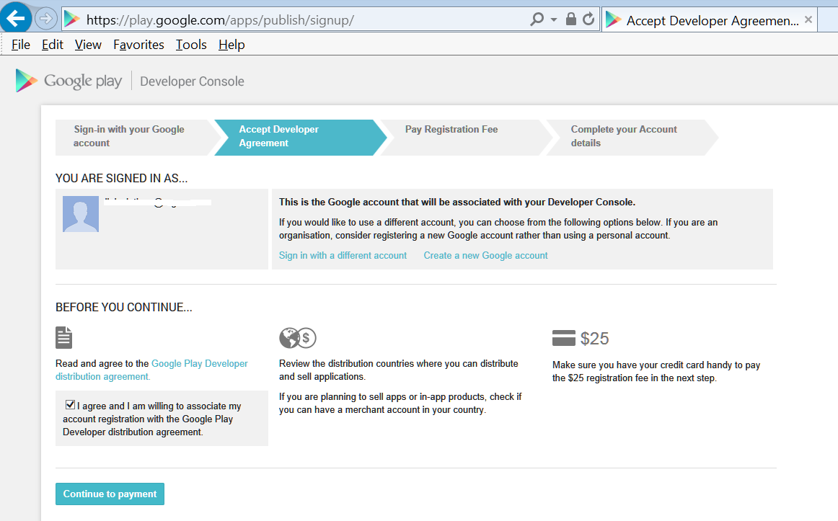
Creating a Developer Profile

Slide 56
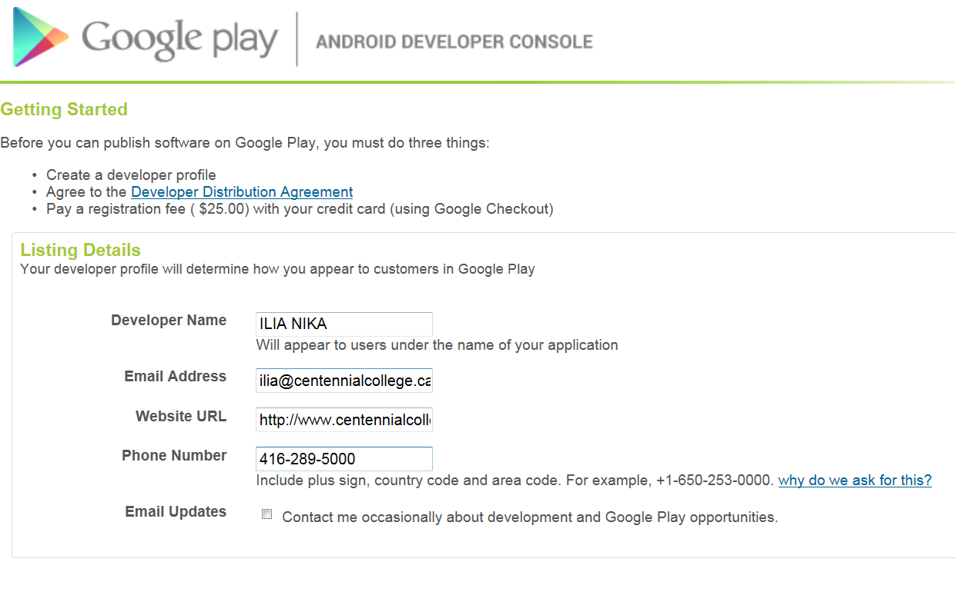
Creating a Developer Profile

Slide 57
Creating a Developer Profile
You need to pay a one-time registration fee, currently U.S. $25.
Click the Google Checkout button to be redirected to a page where you can pay the registration fee.
After paying, click the Continue link.
Next, you need to agree to the Android Market Developer Distribution Agreement.
Check the “I agree” checkbox and then click the “I agree.
Continue” link

Slide 58
Submitting Your Apps
After you have set up your profile, you are ready to submit your application to the Android Market.
If you intend to charge for your application, click the Setup Merchant Account link located at the bottom of the screen.
Here you enter additional information such as bank account and tax ID.
For free applications, click the Upload Application link

Slide 59
Submitting Your Apps
You will be asked to supply some information about your application.
Among the information needed, the following are compulsory:
The application must be in APK format
You need to provide at least two screenshots.
You can use the DDMS perspective in Eclipse to capture screenshots of your application running on the emulator or real device.
You need to provide a high-resolution application icon.
This size of this image must be 512x512 pixels.
The other information details are optional

Slide 60
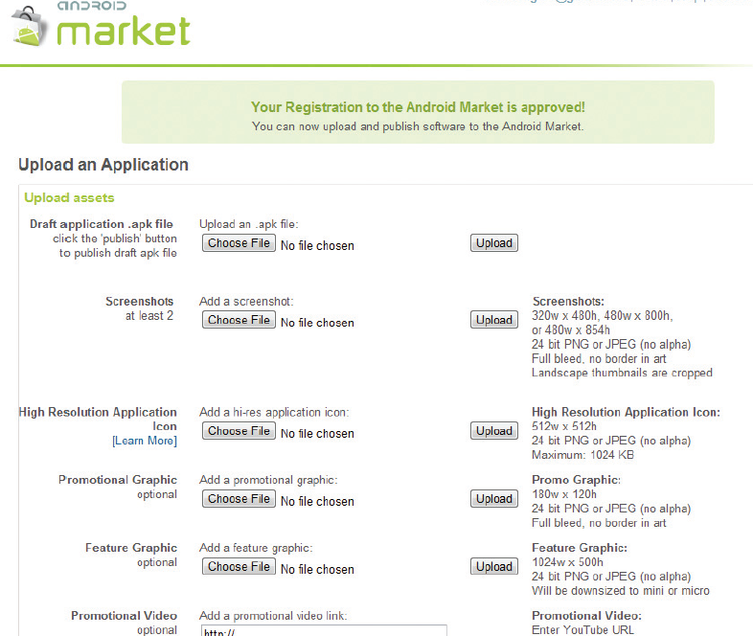
Submitting Your Apps

Slide 61
Submitting Your Apps
The next set of information you need to supply includes the title of your application, its description, as well as details about recent changes (useful for application updates).
You can also select the application type and the category in which it will appear in the Google Play.

Slide 62
Submitting Your Apps
In the last dialog, you indicate whether your application employs copy protection, and specify a content rating.
You also supply your website URL and your contact information.
When you have given your consent to the two guidelines and agreements, click Publish to publish your application on the Google Play.

Slide 63
References
Textbook
Android Documentation
http://developer.android.com/tools/publishing/publishing_overview.html
http://developer.android.com/tools/publishing/preparing.html
http://developer.android.com/tools/publishing/app-signing.html
http://developer.android.com/distribute/tools/launch-checklist.html

